Slide 1
Implementing Illinois Postsecondary and Career Expectations Framework
Eddie Brambila, ISAC
February 2, 2018

Slide 2
Agenda
Background of PaCE
Overview of PaCE
Implementation of PaCE
Resources

Slide 3
Background of PaCE
May 30th, 2015: HR 477 is adopted by IL House of Representatives. Estabilishes advisory committees addressing key areas of Colllege and Career Readiness from P-20 Council
Fall 2015- early 2016: Advisory committees hold meetings to build consensus among key stakeholders. Their recommendations were made in February 2016
May 2016: As a result the Illinois House and Senate unanimously pass the Postsecondary and Workforce Readiness Act (HB 5729) which is made up of four components including postsecondary and career expectations
July 29th, 2016: Governor Rauner signs the bill into law and partners ISAC, ISBE, ICCB and IBHE in developing and establishing a system to ensure high school students are college and career ready.
July 1st, 2017: Deadline for partner agencies to adopt and recommend a framework that outlines Postsecondary and Career Expectations (PaCE)

Slide 4
Components of the Postsecondary Workforce Readiness (PWR) Act

Slide 5
Overview of PaCE Framework
ISBE, ICCB, IBHE, ISAC
7/1/2017
By end of 12th grade
By end of 11th grade
By end of 10th grade
By end of 9th grade
Career Exploration
By end of 8th grade
and Development
A student should be supported to…
A student should know…
A student should have…
Framework aligns with IL Social Science Learning Standards for Financial Literacy in grades 8-12 and
IL Social Emotional Learning Standards grades 6-12
College
E n,
Financial Aid and Literacy
xploratio Preparation,
and Selection
Notes:
Framework aligns with IL Learning Standards for grades 8th-12th and IL Social Emotional Learning Standards grades 6th-12th
“A student should have” is only found at “By 12/31 of 12th grade” – only benchmarks that require certain things to be done (College apps and FAFSA)

Slide 6
Illinois PaCE Framework

Slide 7
Implementation of PaCE - Workshop
Step 1: Taking an Inventory
Step 2: Prioritizing Gaps
ISAC Resources Overview
PaCE Resource Guide
Step 3: Action Planning

Slide 8
Workshop Overview
Step 1: Take an Inventory
What activities are we already doing that help to meet benchmarks in the framework?
What areas are we missing and where can we expand current activities to better serve students?
Step 2: Plan Development: Prioritizing Gaps
How do we prioritize filling the gaps and brainstorm possible activities to meet them?
Step 3: Plan Development: Action Planning
How do we develop an action plan for the remainder of the school year and future years?
How do we document the work we’re doing?

Slide 9
Step 1: Take an Inventory
Worksheets are broken down by category:
Financial Literacy – Post-Secondary – Career
Notes:
Students should know: How can you tell if students know something? Unless you give them some sort of knowledge assessment you can’t. At least provide them with the opportunity to know and understand concepts
Somewhat example: Being done in 11th instead of 9th

Slide 11
Prioritizing Gaps
Things to consider when prioritizing how gaps will be addressed:
How urgent is it that the benchmark be met?
Ex: Start with Senior year and work backwards
How easy or difficult will the activities be to implement into the school schedule/calendar?
Ex: Is this something brand new or can we incorporate the benchmark into an event or activity we already have planned?
Begin Step 2: Enter chosen Priority Number into the provided boxes and transfer them over to the Prioritizing Gaps worksheet
Notes:
Decide as a team how you want to approach the gaps found in Step 1. Make sure seniors are meeting all benchmarks in 3 categories? Focus on a specific category (careers)?

Slide 14
ISAC Resources
Post-Secondary
Financial Literacy
Career Exploration
www.studentportal.isac.org

Slide 15
Student Portal
www.studentportal.isac.org

Slide 16
www.collegechangeseverything.org

Slide 17
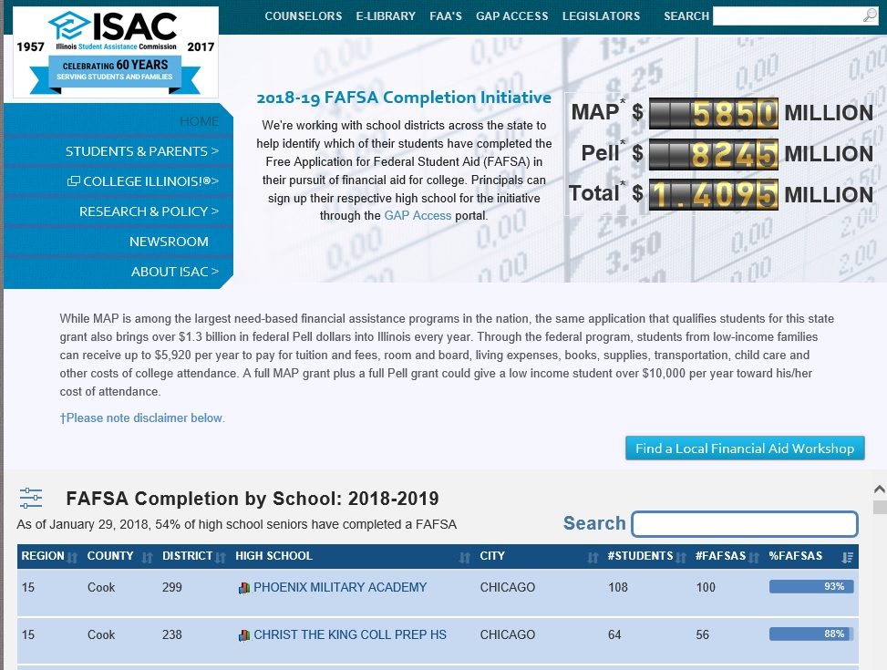
FAFSA Data
Principal signs up school
Visit isac.org and click on “GAP Access” at top of page
Principal designates authorized users
For questions, contact:
Mary Lewis
Mary.Lewis@illinois.gov
www.isac.org/gap-access

Slide 18
ISAC Publications
Order Printed Materials at no cost
The Financial Aid Process
A Guide to ISAC programs and Services
What’s needed for FAFSA postcard
Student Portal Postcard
www.isac.org/ordermaterials/order-materials.html

Slide 19
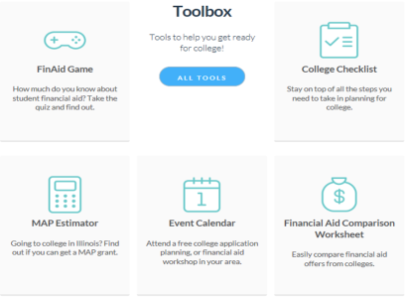
Toolbox
Financial Aid Game
Internships and Summer Jobs
College Checklist
Event Calendar
Financial Aid Comparison Worksheet
Illinois National Guard
Grant (ING) Status
MAP Estimator
www.studentportal.isac.org/toolbox

Slide 20
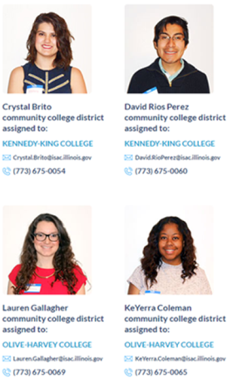
ISACorps
Recent College Graduates
Near-Peer Mentoring
One-on-one assistance for students and their families
College and career exploration
College and scholarship applications
Completing the FAFSA
Presentations and Workshops
The Financial Aid Process
FAFSA Completion Workshops
College Preparation Workshops
Contact Your ISACorps Member
studentportal.isac.org/ISACorps
Abel Montoya – Abel.Montoya@ISAC.Illinois.gov
www.studentportal.isac.org/isacorps

Slide 21
PaCE Resource Guide
Specific resources from our partners to assist with meeting benchmarks
Framework is not a mandate – nothing in the resource guide is required, just meant to assist with implementation
All ISAC partner resources from SALT, IL WorkNet and College Greenlight require student account to access
Includes additional resources from College Board, FSA, Econ IL
ISACorps presentations/activities included in some grade levels
Mix of classroom and parent/evening presentations

Slide 22
Step 3: Action Planning
Develop school/community wide goals and an implementation timeline
Document and track progress
Tailor PaCE framework to what works best at your school and create your own guiding document

Slide 23
Thank you.
Eddie Brambila
Eddie.brambila@illinois.gov

